Slide 1
Database Management System Meghashree Maddihally Nagoji

Slide 2
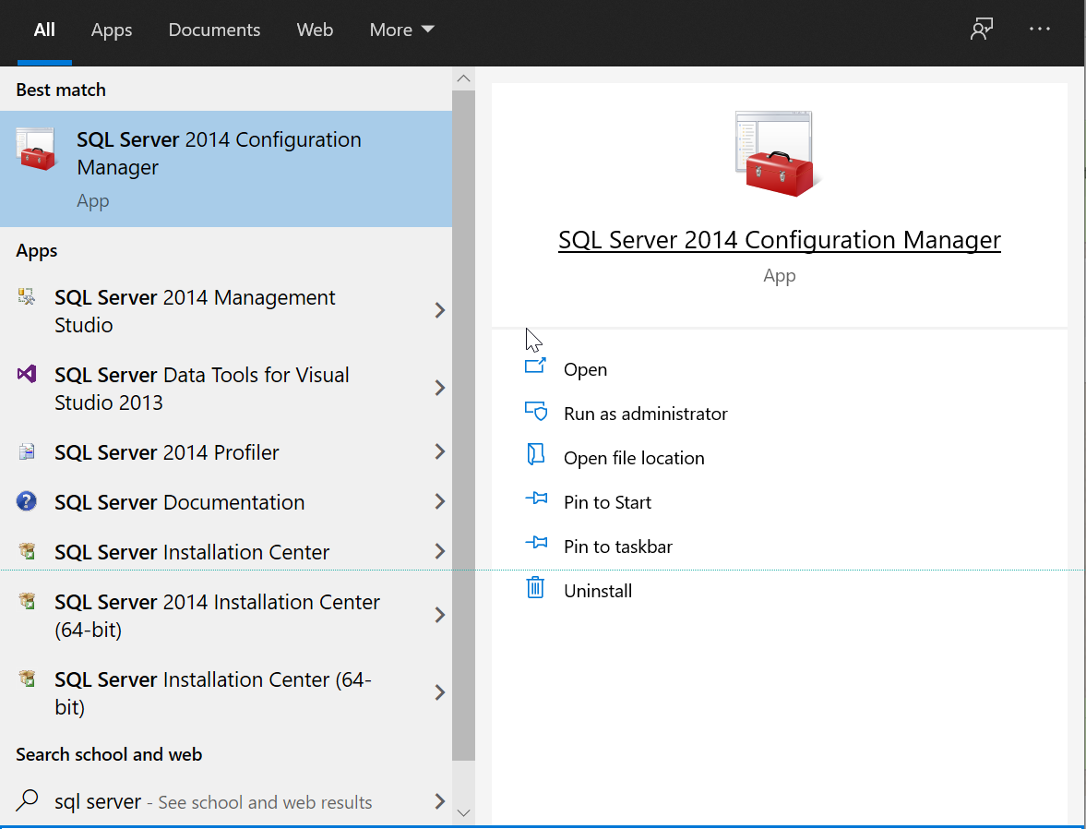
How to start the MS SQL Server?
Search for SQL Server 2014 Configuration Manager in Windows.
Hit Enter.

Slide 3
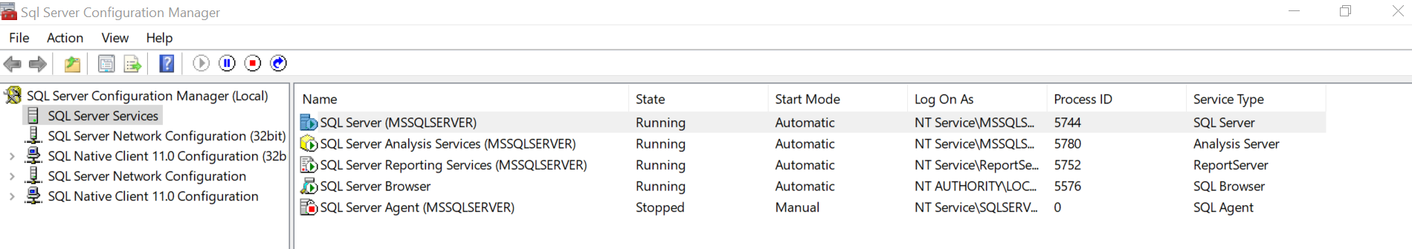
3. Click on SQL Server Services.
4. We can see that the SQL Server Instance MSSQLSERVER is currently running.
5. To start/pause/stop the instance, right click on SQL Server (MSSQLSERVER) and choose the required action.

Slide 4
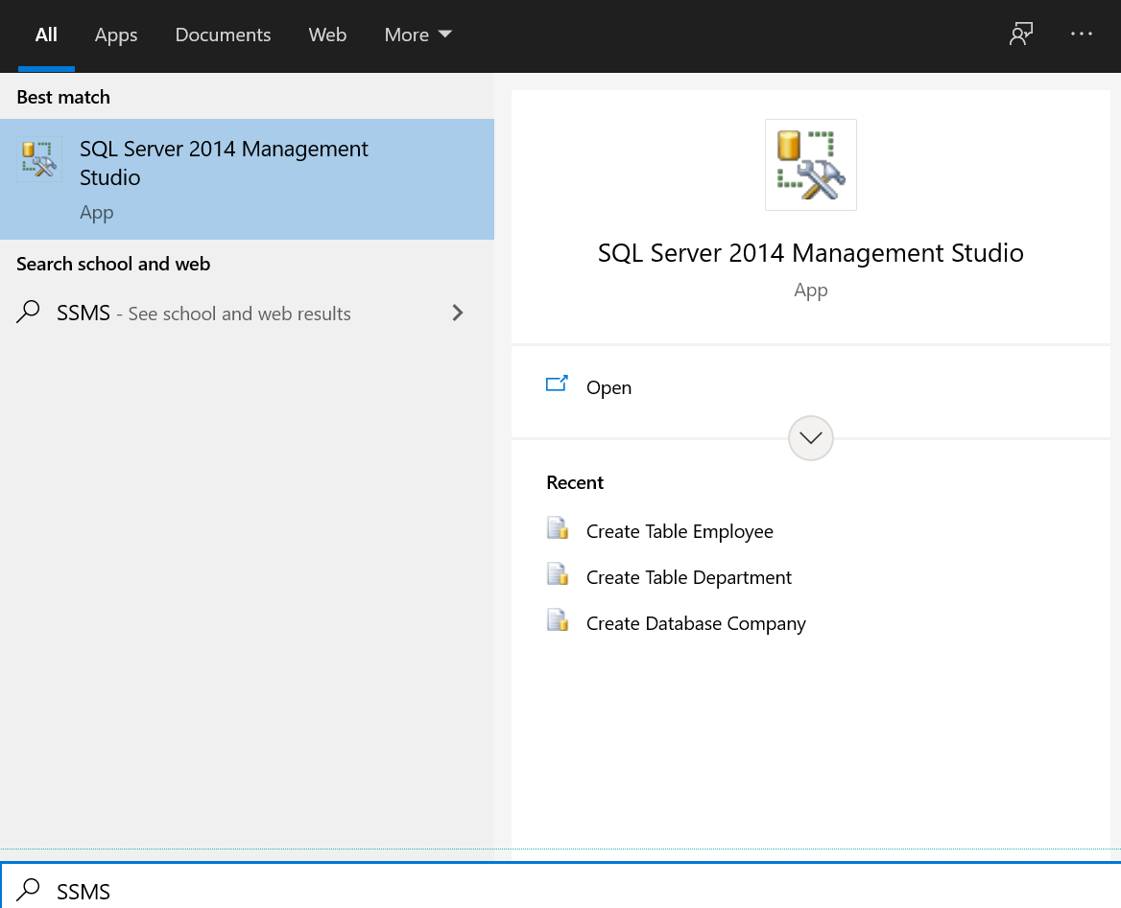
How to Start SSMS?
Search for SSMS in Windows search.
Hit Enter.

Slide 5
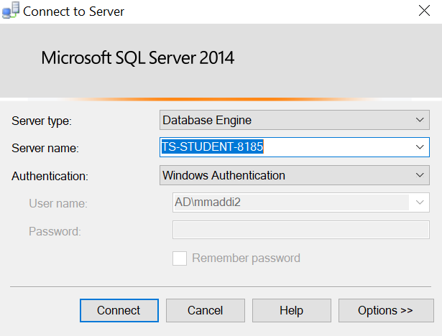
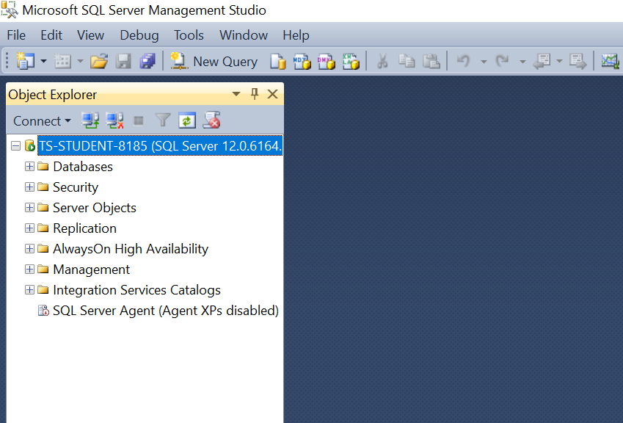
3. Server type – Choose Database Engine.
4. Server name – would be auto populated. You can also browse for the server names from the dropdown.
5. Authentication – Choose the default Windows Authentication.
6. Click on Connect.
7. We are now connected to the server instance TS-STUDENT-8185.

Slide 6
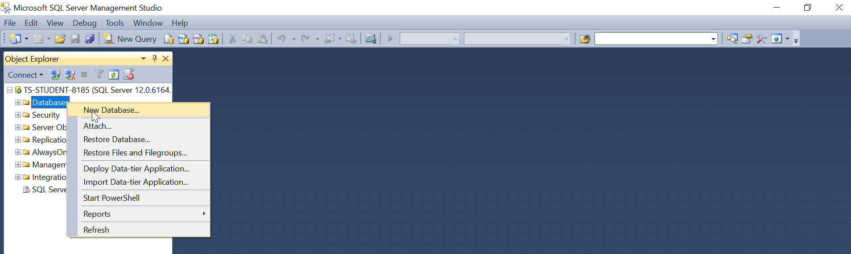
How to create a database?
Right click on the Databases.
Then click on New Database.

Slide 7
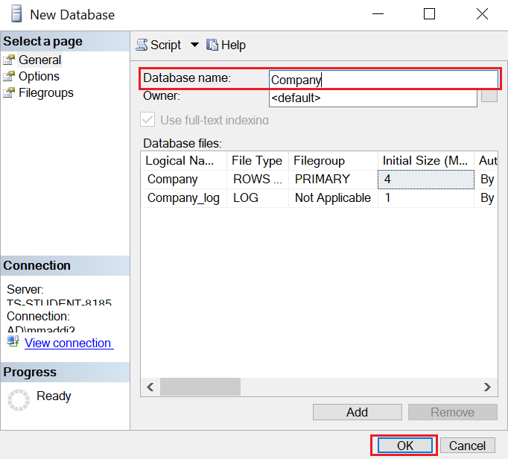
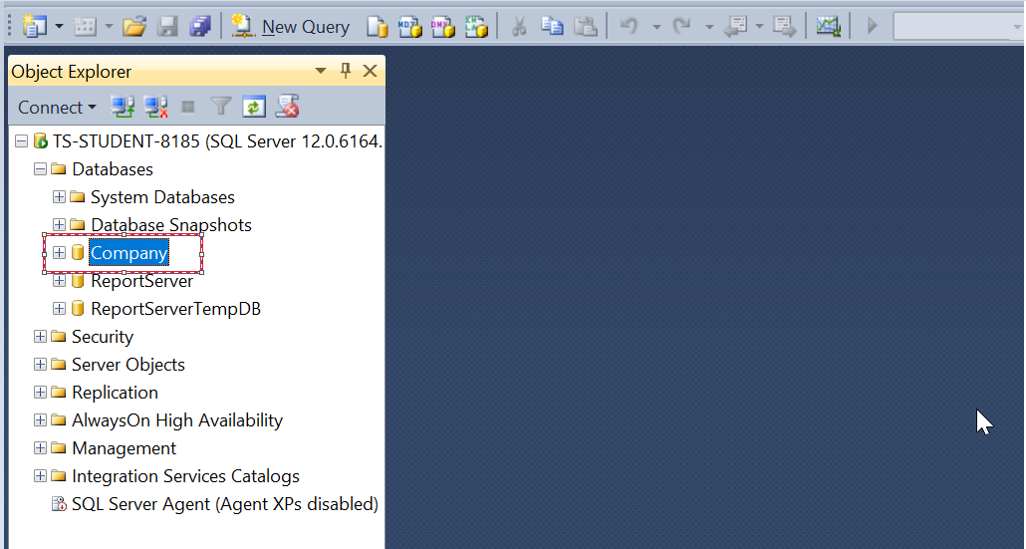
3. Enter the name of the database that you want to create. Here the name is Company.
4. Keep the default settings.
5. Click on OK.
6. New database Company is created.

Slide 8
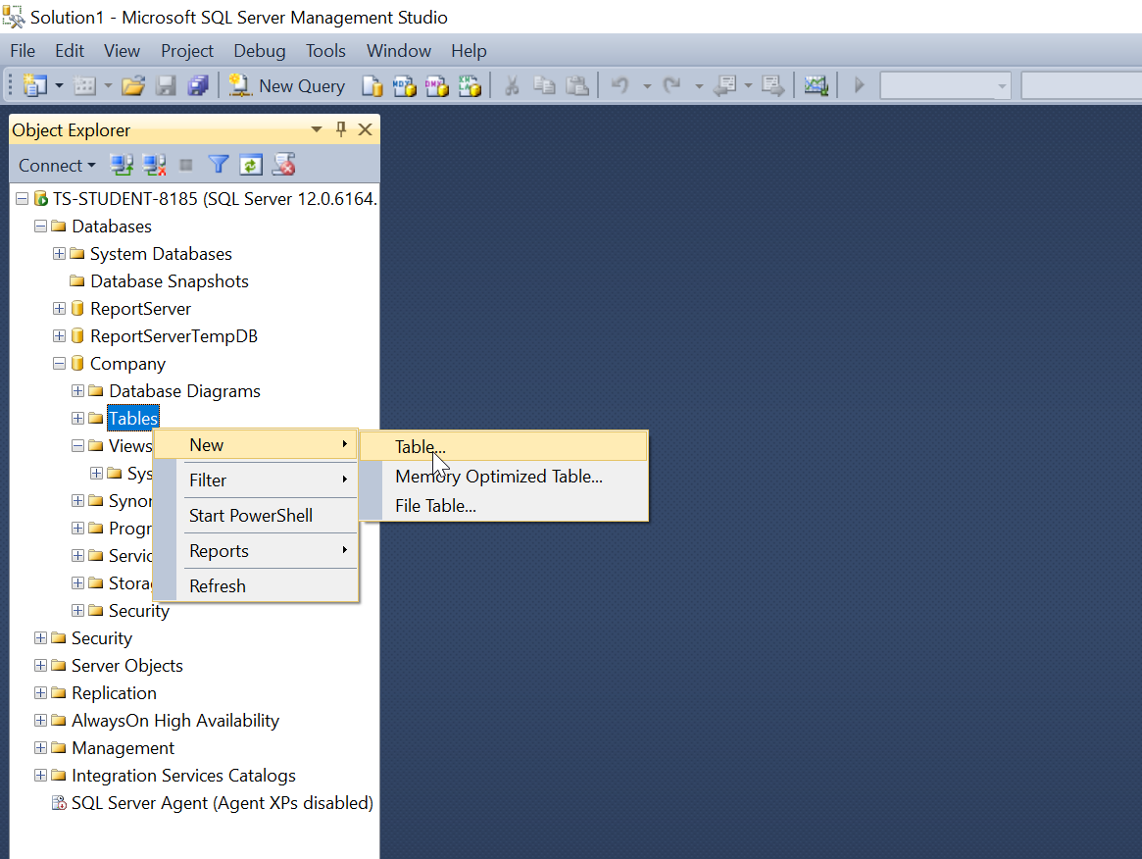
How to create a table(s) with key(s)?
In the Object Explorer, expand the database on in which you want to create the table. Here the database is Company.
Right click on the Tables option.
Choose New.
Further choose Table.

Slide 9
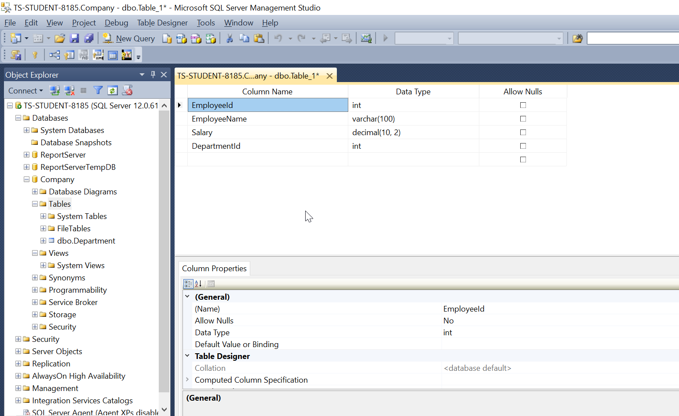
5. Enter the names of the columns under Column Name, choose the data types under Data Type and check the Allow Nulls box for the columns which allow null values.

Slide 10
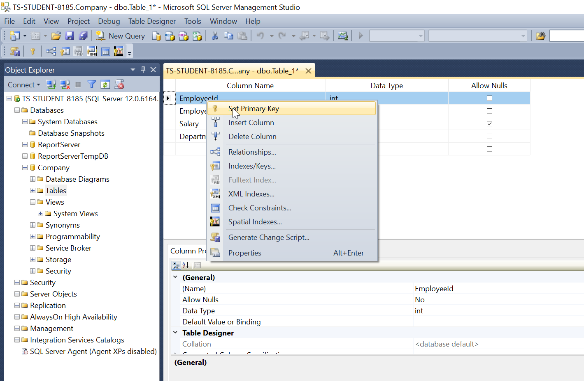
6. Right click on the column which is the primary key for the table. Here right click on EmployeeId column.
7. Click on Set Primary Key. Now EmployeeId is the primary key of the table.
8. Save the table name as Employee.
Employee table is created.

Slide 11
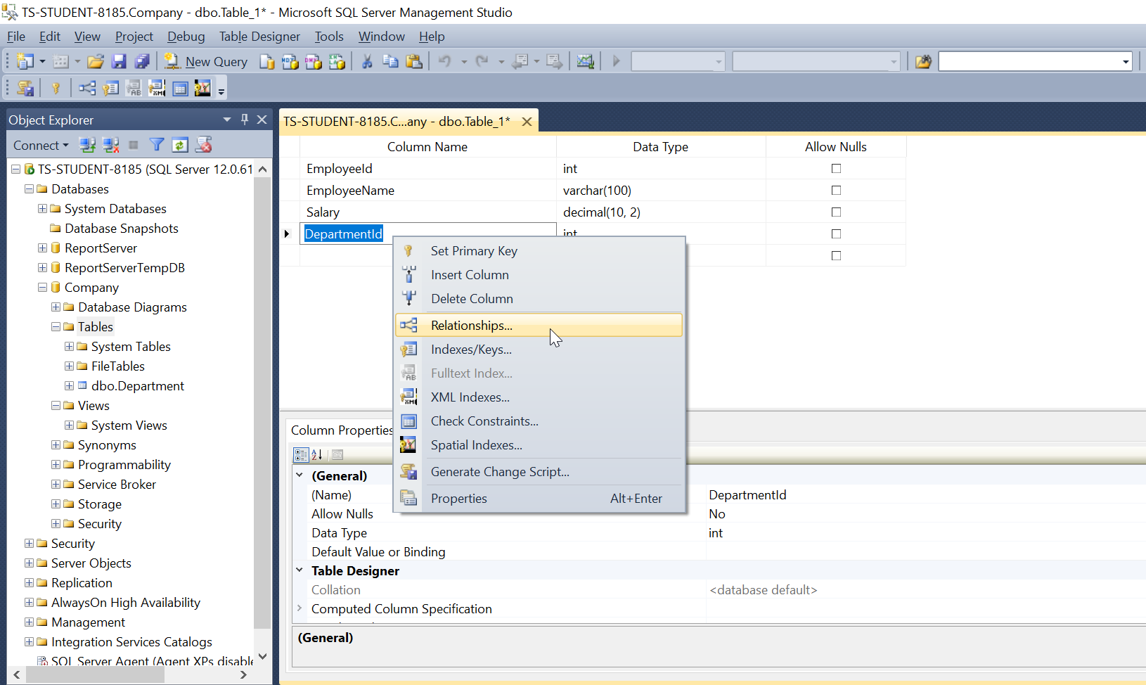
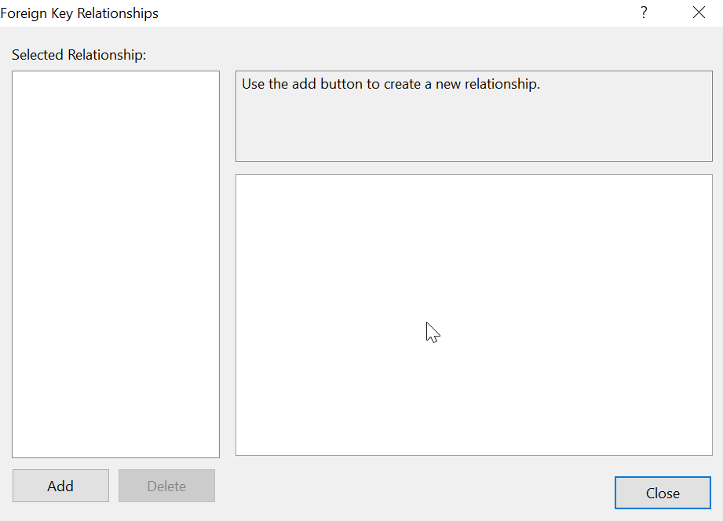
8. To create foreign key relationships, right click on the column which is a foreign key. Here right click on DepartmentId column. Choose Relationships.
9. Click on Add.

Slide 12
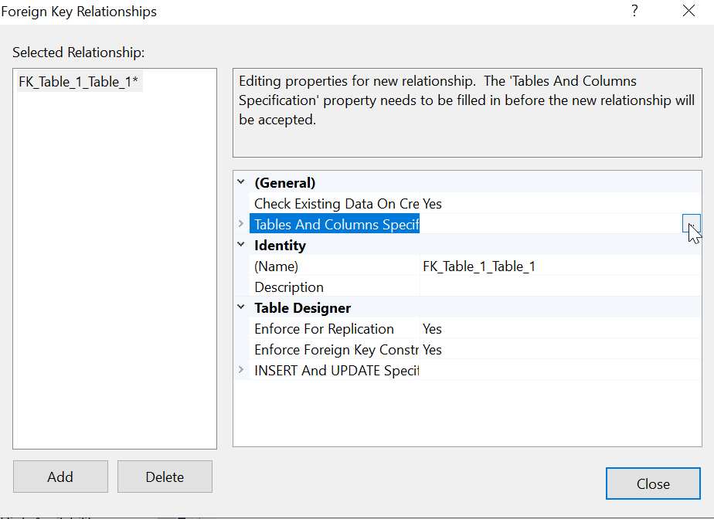
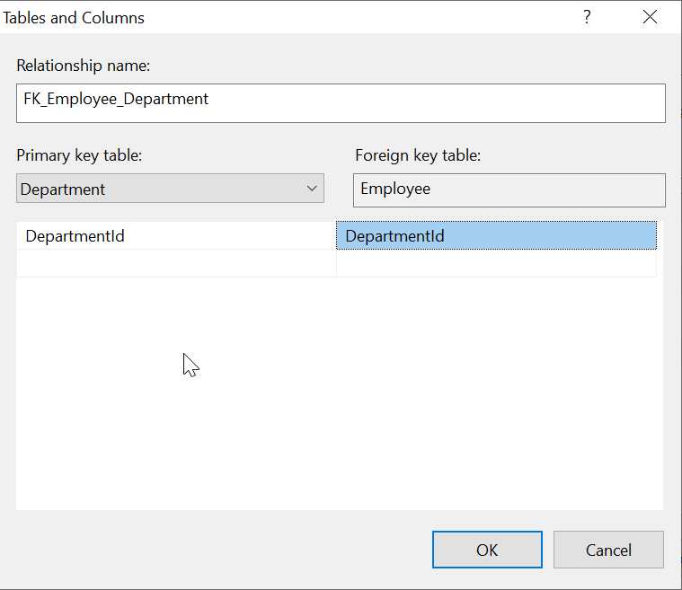
10. Click on Tables And Columns Specification.
11. Choose the Primary key table from the dropdown. Here it is Department (already existing table which has DepartmentId as primary key).
12. Foreign key table would be Employee.
13. Choose the column names for both the tables. Here it is DepartmentId.
14. Click on OK, then Add.
15. Foreign key relationship FK_Employee_Department is created.

Slide 13
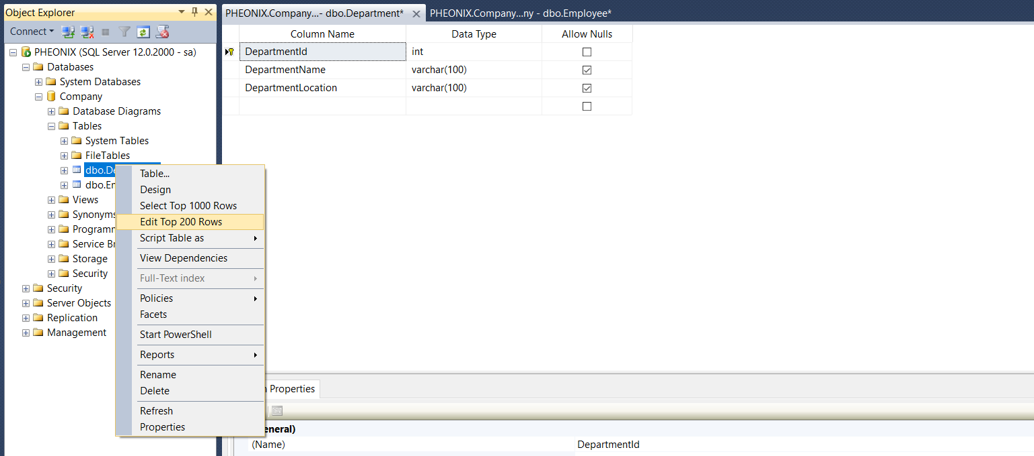
How to provision Tuples?
Right click on the created table.
Select edit top 200 rows.

Slide 14
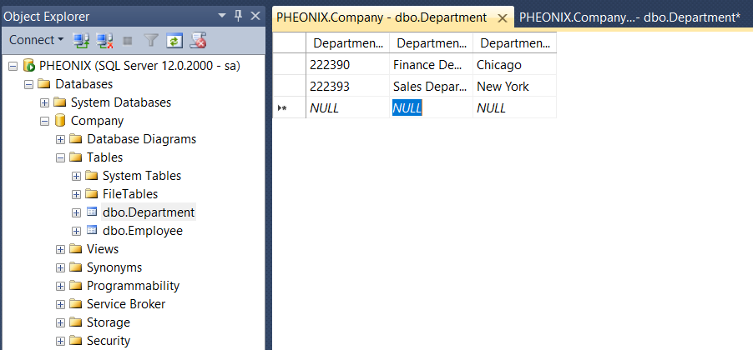
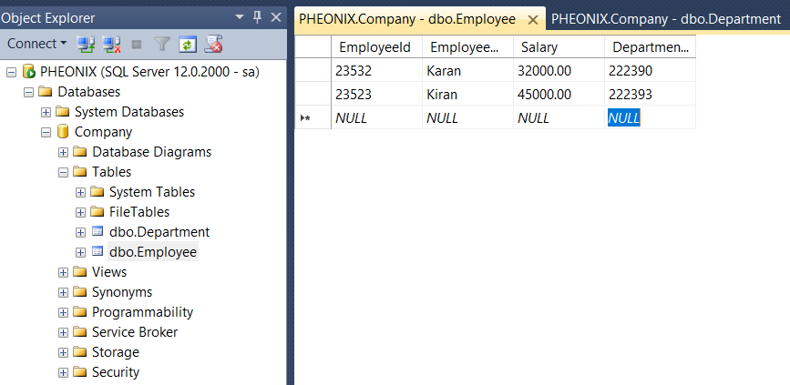
3. Enter values for each variable with respect to their data type.

Slide 15
Making a Query
In the object explorer, attach the database.
In the Object Explorer, right-click on the database that needs to be edited and select New Query from the menu.
A new tab window will open on the right side.
In the new window, type the query lines that dictate the changes to be applied to the database.
To execute a query, use the Execute command in the application toolbar. After the process is finished a confirmation message will be displayed at the bottom of the query window, stating that the query was executed successfully. The changes are automatically applied to the database and it can be used accordingly.

Slide 16
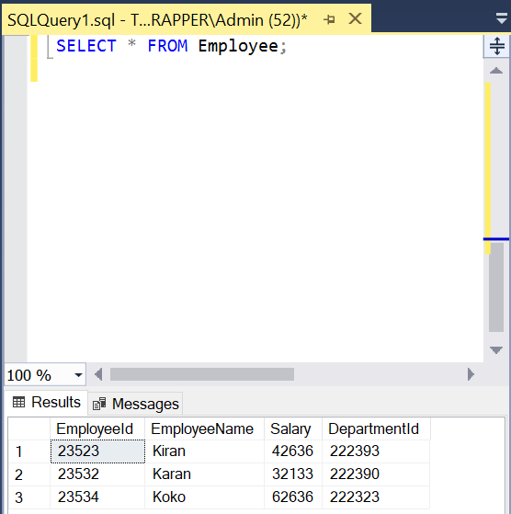
Sample Query
1. Paste the code in T-SQL code snippet into
the query window and then select Execute.
2. The results of the query are displayed
under the area where the text was entered.

Slide 17
View
View is a type of SQL Query and is like a virtual table.
The data could be queried from one or more tables in a view.
There 3 types of Views: Read-Only View, Updatable View & Materialized View.

Slide 18
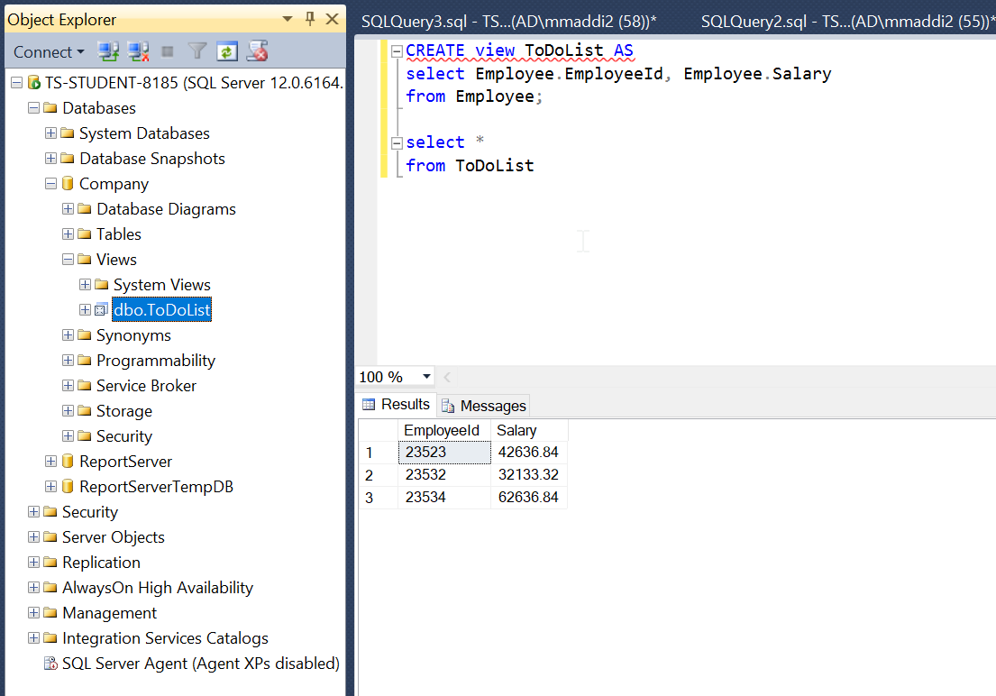
Example of a View

Slide 19
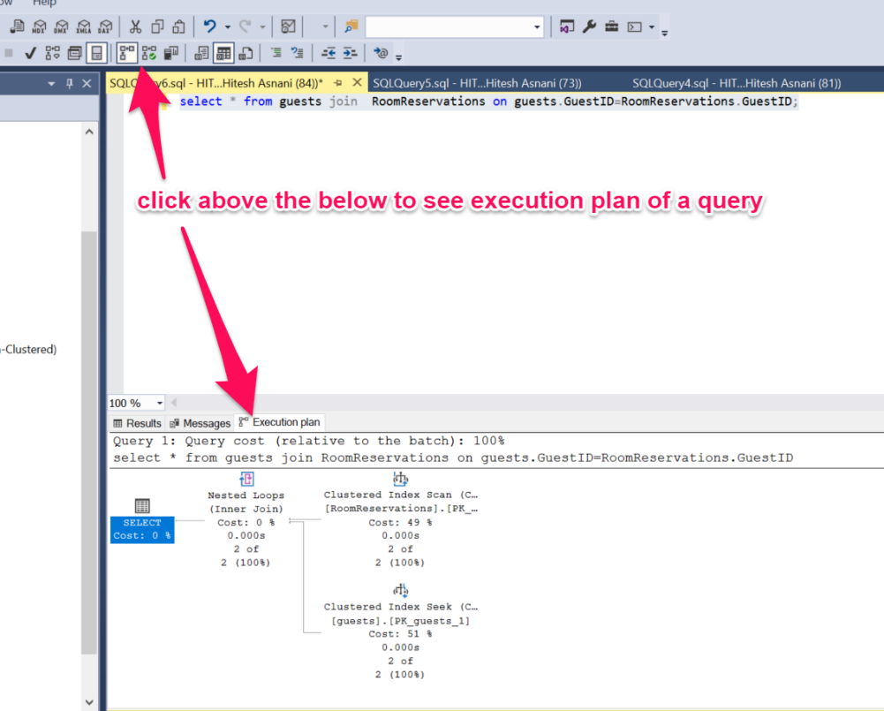
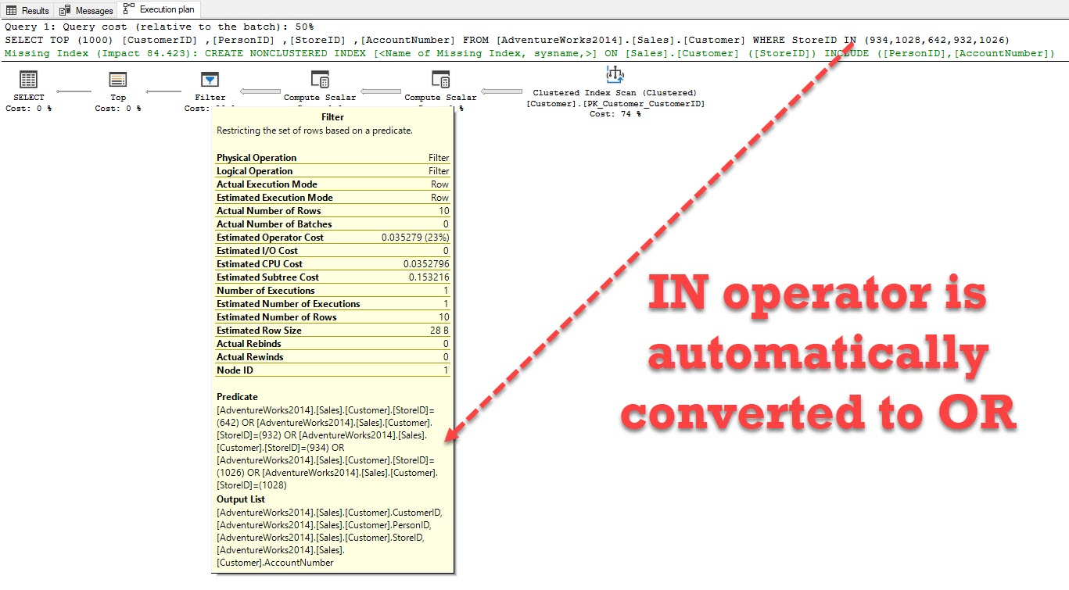
Useful Features Used By Group
Query Performance

Slide 20
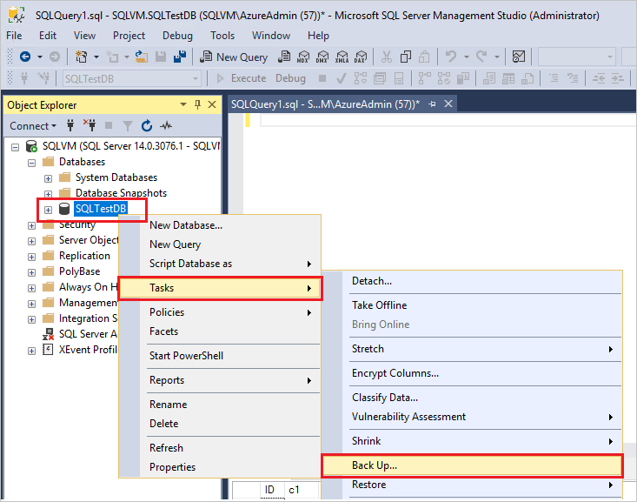
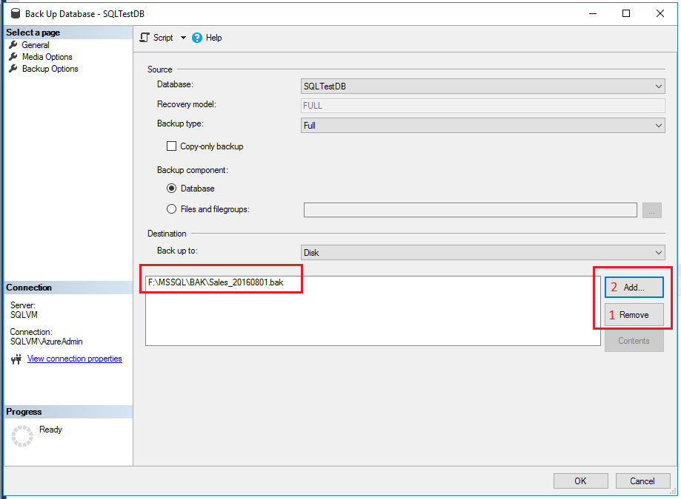
Backup Feature
Example Query for Backup
BACKUP DATABASE Student To Disk C\Student.bak WITH INIT, BLOCKSIZE2048

Slide 21
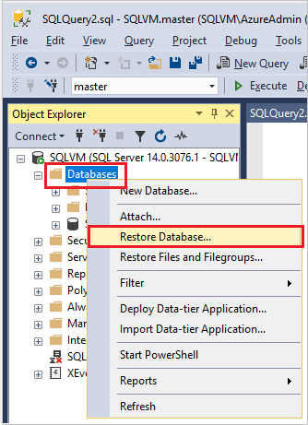
Restore Feature
Example Query for Restore
RESTORE DATABASE Student FROM Disk C\Student.bak WITH RECOVERY

Slide 22
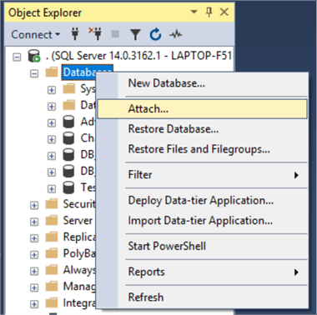
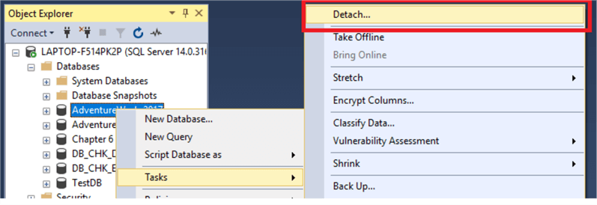
Detach/Reattach Database Feature

Slide 23
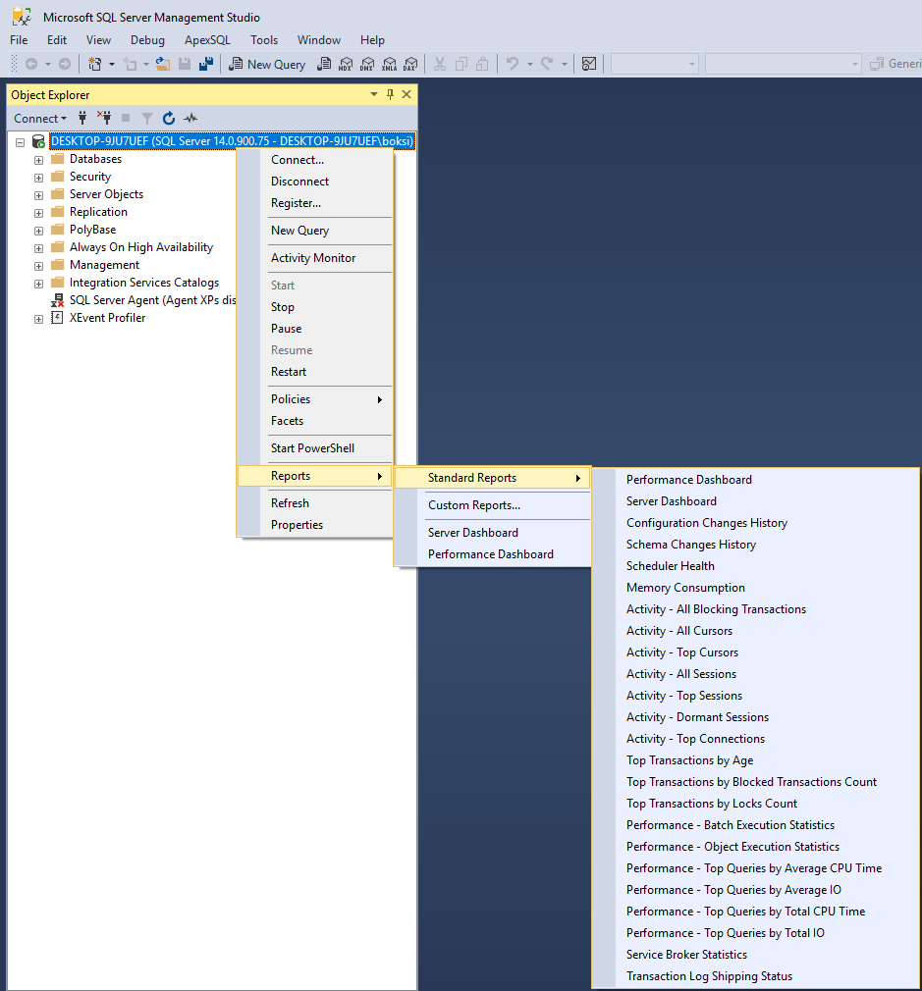
Multi Operational Dashboard
Example Generation of Reports.
Numerous features can be accessed through the dashboard or menu option.

Slide 24
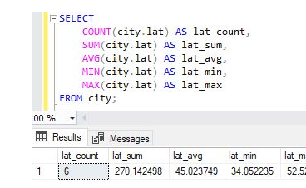
SQL Aggregate Functions
1. Sum - The Sum of values
2. Count - The number of items in a set.
3. Avg - Calculates the average values of a set
4. Min - The minimum value in a set
5. Max - The maximum value in a set

